Slide 1
TAP THAT
THE PIVOT
From vanity to sanity — a strategic evolution, not a rebrand.
Prepared by Jewell Projects for the Founders of Tap That
Notes:
The recurring issue is focus and prioritisation. The strategy (AI-driven) is broad. Too many beer options for consumer (more of a product-centric approach) which means a lack of focus in the product assortment. Marketing trying lots of different things and giving up when they don't initially work and moving on to next. Owner and marketing team spending time propping up the failing business unit at the expense of the profitable ones.
I get it, Tap Room is ego driven. A beauty contest. To pivot is difficult because owner is anchored to the sexy part of the business. But what Tap That is doing is akin to the girl who spends all her money on makeup so there's no money left to join a gym to get healthy.
My role is not as someone who has built a small business previously, but as someone who has built consumer brands with the discipline of the best in the business. My objective is to give the owner the permission and structure to pivot.

Slide 2
WHAT WE SAW + HEARD
The overall plan is sound. Focus and shape is the unlock.
Strategy is insightful, comprehensive and sound. Justin’s mental model that everything feeds refills is spot on.
But the plan is AI theoretical with too much equivalence and too many directions.
Some of its own insights are directionless which obscure the gold.
Two key business units, thought to be complementary are in reality pulling in opposite directions, creating a zero-sum game.
A great refill business detracts from Tap Room traffic
Meaning more effort to drive new traffic (high CAC)
We’re at MVP with refills BU. But only refills and only beer.
The weakest performer is getting the support, at the cost of the units that actually work. Watering the weeds, not the flowers.
The offer is unique, the product is good, but the stars can’t shine.
We suspect a long tail of beer options is driving COGS
And we propose its causing consumer choice paralysis
Chasing two rabbits, catching neither
For all the right reasons, marketing explores many ideas, quits, and moves on.
Marketing’s time gets spent propping up the failing unit at the expense of the profitable ones.
In danger of dying with a beautiful corpse
Running a brewery is hard. Hospitality even harder. Trying to do both with a skeleton staff is mental.
Permission needed to re-shape the business
Notes:
Nothing here will be new news. You know it already – the value is in having an impartial third party confirm it for you and give you permission to evolve.

Slide 3
TAP ROOM IS VANITY. REFILLS ARE SANITY.
96–113
56%
20%
Active customers, high recurring orders — this is MVP status.
of refill customers bought their tap system elsewhere — the refill proposition is already validated.
of system buyers are said to have visited Tap Room — but that’s correlation, not proven causation. An aspirational destination model likely reaches the same fans. Maybe more.
Tap Room works as an event/function destination. It doesn’t work as a walk-in — the footfall isn’t there. Task now: brutally edit the losers, invest in what’s proven.

Slide 4
WHERE TO FROM HERE — CORE
Get the core right, then go for more.
1
2
3
4
5
Tap Room: Pause & Pivot
Convert the Owners Already Sold
Remove all Friction in refills
Rationalise the range
Ride the Wellness Wave
Pause walk-in trading. Go all-in on destination demand.
Objections are already overcome for existing kegerator owners.
Every extra step in the refill process potentially costs a sale.
Create ‘hero’ products to leverage social proof and cut the non-productive tail.
Also the way back to lapsed customers.
PROOF: Event/function nights already profitable
PROOF: 56% bought their system elsewhere
PROOF: 10% reorder monthly, 40% far later — one clock fails both
PROOF: Approx 19 brew choices – loses the ‘curated’ and only the best position
PROOF: 40% of lapsed cite “cutting back”
PR: tourism, event planners, wedding planners
Own the tour circuit — Urban Legends booking tool, Pineapple Tours, Crafted award callout
Ticketed events
Colab events
Party rental —reduce friction: minimum-guarantee kegs to cover the rental cost
Harvey Norman GWP / POS tie-up + buyer database
Buy Kegland / corny-keg owner databases
Official Benchy partnership + database
Co-branded outdoor BBQ + system bundle
Free delivery always works; recover margin in $, not %
Replace blanket 90-day SMS with consumption-triggered reminders
Highlight the simplicity of no CO2, pick-up-and-go
Simplify membership(s), refill centric
Get Justin off the bar and onto the road
Deeper product marketing on the remaining brewSKUs
Introduce ‘social proof’ cues (out most popular etc)
Low / NA / low-carb / protein range
Wellness influencer collabs — amplify or co-develop
Reframe for the “cutting back” cohort as healthy-alternative, not less beer

Slide 5
WHERE TO FROM HERE — MORE
Once the core is running, extend it.
6
7
8
9
10
Full Press on Wholesale
Design For Her
Hyperpersonalise communiations and LTV
Make the Kegerator PR-able
Package Around the Duopoly
Resourced, structured, KPI’d — no more falling through cracks.
Covered isn’t the same as catered for.
This needs a process, not a message.
Turn the system itself into desire.
Locked-in venues still have real pain points.
PROOF: 1 wholesale account ≈ 10 households
PROOF: Passion for brews is real — range doesn’t reflect it
PROOF: Buying cycle: ~60% within 3mo, 40% longer
PROOF: 1,000 giveaway entries = proven demand
PROOF: Contractual lock-in ≠ customer satisfaction
Hire an FTE or agent
Set targets and KPIs
Custom systems for sporting clubs; minimum-guarantee kegs/season
Move rigs footy → cricket for year-round occupancy
Romance the shit out of the RTD
Build the hydration story through wellness/light range
Products she’s proud to serve
Systems designed to sit in eyesight at home
Track consumption to predict the next refill
Re-engage lapsed by actual reason — cutting back vs. forgot
Trigger-based outreach, not calendar-based
Personal details – anniversaries, footy finals etc.
UGC mechanic — tag Tap That, get a discount
“Own your keg” personalisation, like a whiskey bottle
Explore short-term / occasion rental for parties
Consider packaged offer to work around contracts
Look for the judo move to use their size against them: no lock in contracts, profit share model, white labeling etc.

Slide 6
Notes:
"Pilslates" works exceptionally well because the weight, shape, and stability challenges of a keg (or mini-keg/growler) mirror classic Pilates apparatus like the Wunda Chair or Barrel. Using kegs for resistance and balance tests core stability, control, and breath without the high cardiac impact of traditional HIIT movements.
Keg Rollouts (Abdominal & Lats)
Setup: Kneel on a mat or pad facing a empty or light mini-keg placed horizontally on the floor. Hands placed on top of the keg.
Movement: Keeping the core zipped up and hips forward, roll the keg forward away from the body, extending into a long plank position, then use the lower abdominals and lats to roll the keg back to the starting position.
Pilates Concept: Mirrors the Ab Wheel / Reformer Elephant Rollout, demanding deep pelvic stability and spine extension control.
Keg Teaser with Oblique Twist
Setup: Seated on the floor in a "V" sit posture, holding a light mini-keg or empty growler at chest height.
Movement: Balance on the sit bones with legs lifted (or knees bent in tabletop). Rotate the torso to tap the keg to the right hip, return to center, and tap to the left hip.
Pilates Concept: A direct variation of the classic Pilates Teaser, targeting the transverse abdominis and obliques while maintaining balance.
Single-Leg Keg Bridges
Setup: Lie on your back with arms relaxed at the sides. Place one foot flat on top of a stationary flat keg (or sturdy wooden barrel), with the other leg extended straight up toward the ceiling.
Movement: Press down through the foot on the keg to articulate the spine up into a bridge position, pausing at the top to squeeze the glute and hamstring, then roll down vertebra by vertebra.
Pilates Concept: Replicates the Pelvic Curl / Bridging on the Pilates Chair, testing hamstrings and core symmetry on an elevated surface.
Keg Mermaid Side Bend
Setup: Sit in a side Z-sit (mermaid position) with one hand resting on top of an upright full/heavy keg to the side.
Movement: Reach the opposite arm overhead, inhaling to side-bend toward the keg while using the keg for light support and resistance. Exhale to engage the side waist and pull back to center.
Pilates Concept: Classic Mermaid side stretch and lateral spine articulation using the keg as a stable anchor point.
Keg Single-Leg Deadlift to Plié Squat
Setup: Stand tall holding a mini-keg or empty keg by the handles at hip level.
Movement: Hinge forward on one leg into a single-leg deadlift (Warrior III balance), bringing the keg toward the floor. Return to standing, step wide into a sumoplié squat, and lower into a deep wide squat holding the keg at chest level.
Pilates Concept: Low-impact isometric leg work focusing on alignment, balance, and inner thigh/glute activation.

Slide 7
B2C FLYWHEEL: THE SIGNATURE WEDDING BREW
Turning Hens & Bucks Days into Wedding Day Volume and Direct-to-Consumer Growth
VISUAL MOCKUP
THE 4-STEP JOURNEY
STRATEGIC COMMERCIAL IMPACT
1
The Tap Room Event
High-Margin Function Revenue
500ml
CAN
20L COMMERCIAL
KEG
Private Hens or Bucks session. Guided flight tasting across 27 taps with interactive ingredient blending.
Captures premium venue hire and group tasting packages upfront.
“Sarah & Mark’s Matchmade IPA”
2
Bespoke Branding
Co-branded custom label, naming, and beverage style selection — Beer, Sour, Seltzer, or RTD Spirit.
Guaranteed Bulk Volume
Label Design: Bold industrial layout — Tap That branding + custom couple details (e.g. “Bucks Day Blood Orange RTD”).
Secures pre-sold beverage volume for wedding reception catering.
3
Wedding Day Reception
Aesthetic: Exposed brick, matte black, timber textures, bold sans-serif type.
Bulk supply delivered in 20L kegs or custom cans for the main event.
Organic Customer Acquisition
4
Take-Home Flywheel
Converts wedding guests into home-kegerator hardware and keg-subscription leads via sample QR codes.
SCAN TO ORDER HOME KEGS &
DRAFT EQUIPMENT
Every wedding guest receives a branded take-home sample.
THE ECOSYSTEM EFFECT Every wedding serves as a live, self-funding brand activation that puts custom Tap That products directly into the hands of 100+ targeted consumers.

Slide 8
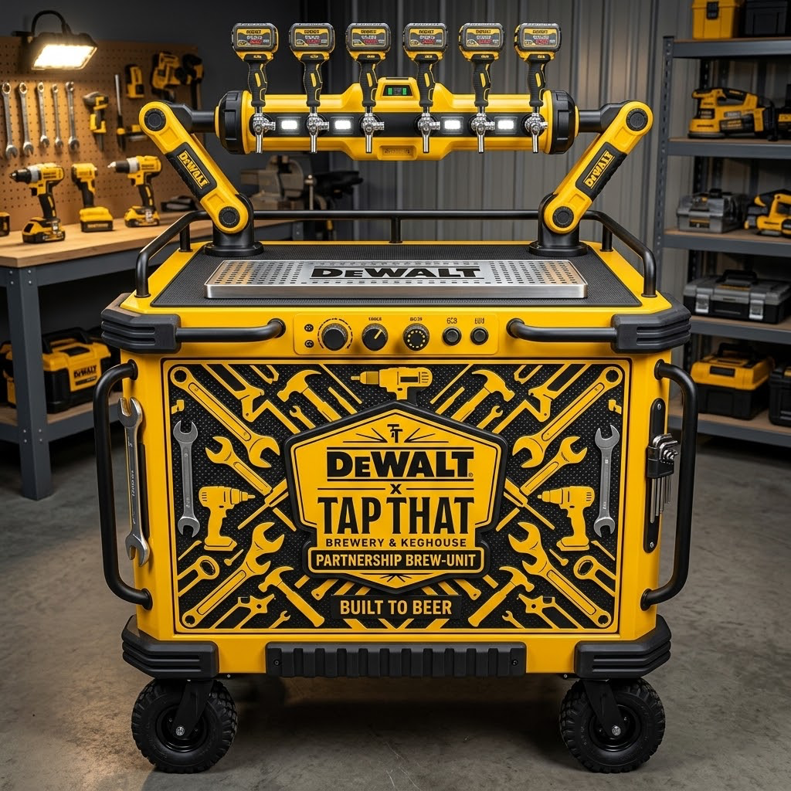
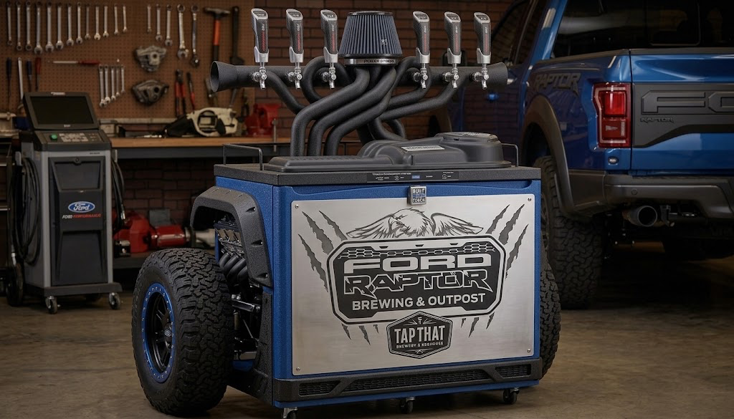
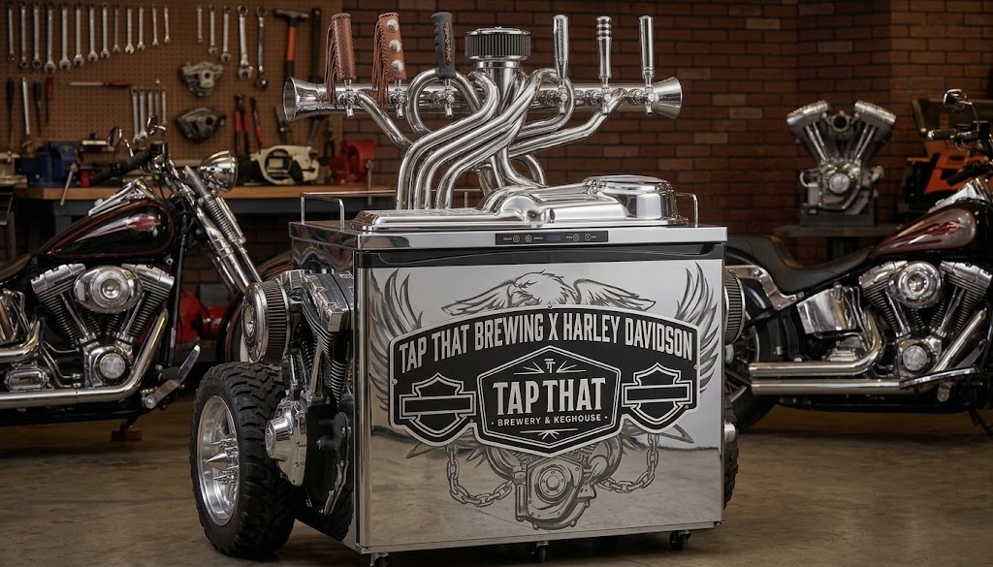
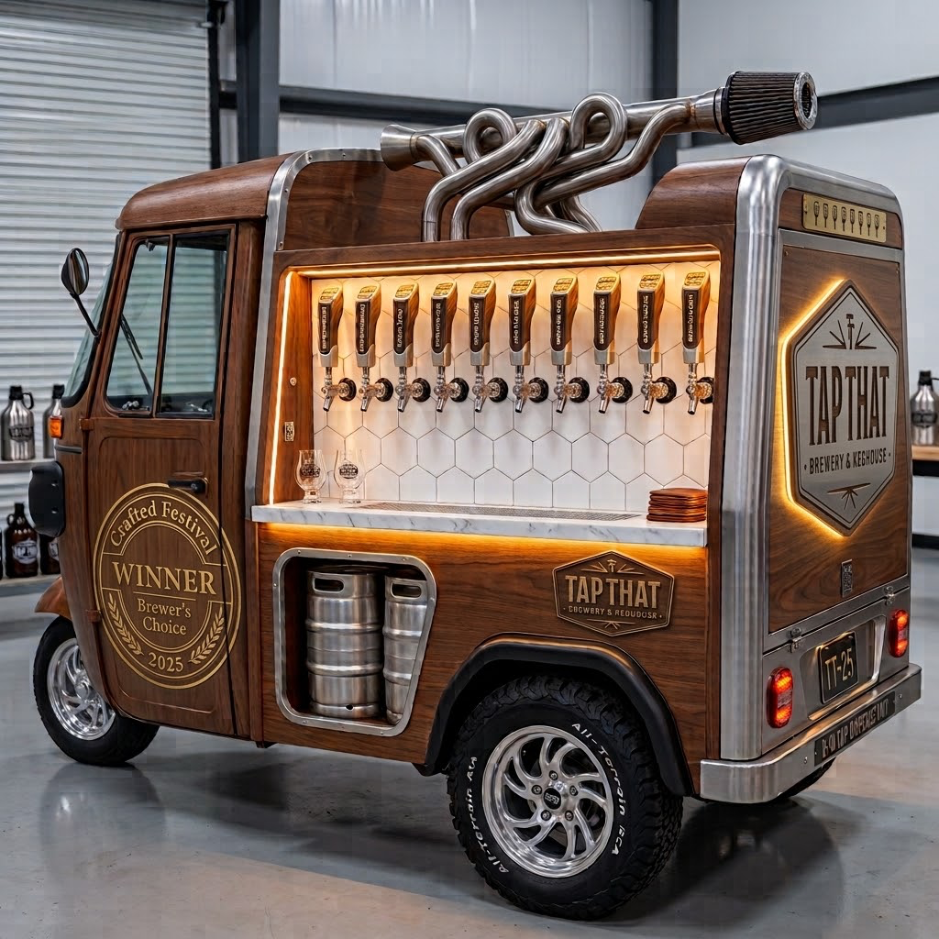

Slide 9
OTHER STRATEGIC NOTES
Who’s the Real Enemy?
Handle the Census With Care
Overpriced pubs — not the duopoly, not A&A or the keg-delivery operators. Speak in unit economics everywhere. Don’t get pulled into a keg price war you don’t need to fight.
~50 people, forced-choice answers. People don’t always know — or say — why they buy. Status, “wanting to be seen as successful,” compensating for something else: real drivers, rarely spoken. Useful colour. Not a strategy map.

Slide 10
HOUSEKEEPING — WEBSITE & BRAND
Small fixes, disproportionate impact.
Above the fold
No hook, background film cut too fast to read, copy pollution, low-res static logo.
Missing proof
Crafted Brewers’ Choice award, “fits any system” callout, and strong reviews are buried below the fold.
Hierarchy
Four business units treated equally. Prioritise the moments that matter — family, friends, the ‘proud provider’ role.
Category
“Commercial brewer” invites mainstream price and product comparisons. Needs an elevated category name of its own.
Channel language
“Wholesale” should speak directly to Restaurants and Sporting Clubs — cuisine matching, club-branded kegs, straight to the margin story.

Slide 11
WHERE JEWELL PROJECTS CAN HELP
FROM THE BRIEF
ALSO WORTH ADDING
Website design optimisation
Trigger-based CRM / lifecycle build — fixes the 90-day SMS problem
SEO / GEO best-practice implementation
Membership program redesign
PR outreach — tourism operators, experiential platforms
Influencer outreach
Wholesale structure & KPI framework
Partnerships outreach & PM — BBQ brands, system collabs
Urban Legends collaborative booking tool

